Slide 1

Leveraging Global
Legislations in Conducting Effective Trials
National Judicial Academy, Bhopal
March 26, 2016
Kunal Gupta

Slide 2
Agenda
Why should I care about global anti-corruption legislations?
What are the key global anti-corruption legislations that I should be concerned with?
How can I leverage knowledge from these legislations?
What are the next steps?

Slide 3
Examples of such disclosures related to India
Excerpt from Walmart’s disclosure under 10K before SEC
The Audit Committee of our Board of Directors, which is composed solely of independent directors, is conducting an internal investigation into, among other things, alleged violations of the Foreign Corrupt Practices Act ("FCPA") and other alleged crimes or misconduct in connection with certain of our foreign subsidiaries, including Wal-Mart de México, S.A.B. de C.V., or Walmex, and whether we appropriately handled prior allegations of such violations and/or misconduct. We are also conducting a voluntary global review of our policies, practices and internal controls for FCPA compliance and strengthening our global anti-corruption compliance programs. Since the implementation of the global review and enhanced anti-corruption compliance programs, the Audit Committee and we have identified or been made aware of additional allegations regarding potential violations of the FCPA. Inquiries or investigations regarding allegations of potential FCPA violations have been commenced in a number of foreign markets in which we operate, including, but not limited to, Brazil, China and India. In November 2011, we voluntarily disclosed our investigative activity to the U.S. Department of Justice (the "DOJ") and the SEC, and we have been informed by the DOJ and the SEC that we are the subject of their respective investigations into possible violations of the FCPA.

Slide 4
Excerpts from disclosures made by Mondelez (Cadbury) in its filings
A compliant and ethical corporate culture, which includes adhering to laws and industry regulations in the United States and abroad, is integral to our success. To this end, after we acquired Cadbury in February 2010 we began reviewing and adjusting, as needed, Cadbury’s operations in light of U.S. and international standards as well as Kraft Foods’ policies and practices. We initially focused on such high priority areas as food safety, the Foreign Corrupt Practices Act (“FCPA”) and antitrust. Based upon Cadbury’s pre-acquisition policies and compliance programs and our post-acquisition reviews, our preliminary findings indicated that Cadbury’s overall state of compliance was sound. Nonetheless, through our reviews, we determined that in certain jurisdictions, including India, there appeared to be facts and circumstances warranting further investigation. We have undertaken these investigations, which are ongoing.
On February 1, 2011, we received a subpoena from the SEC. The subpoena, issued in connection with an investigation under the FCPA, primarily relates to a Cadbury facility in India that we acquired in the Cadbury acquisition and primarily requests information regarding dealings with Indian governmental agencies and officials to obtain approvals related to the operation of that facility. We are cooperating with the U.S. government in its investigation of these matters.

Slide 5
Example from multilateral organizations
….. WASHINGTON: The World Bank has debarred Consulting Engineering Services (India) for five years on charges of fraud and corruption in an NH project in India.
The decision follows a World Bank investigation and review of poorly performing road construction contracts under the bank-financed project, for which CES was the supervision consultant, the bank said in a statement on Friday.
Consulting Engineering Services (CES) will not qualify for any contract financed by the World Bank Group during the five-year debarment, which came into effect on Friday.
“The debarment is part of a Negotiated Resolution Agreement between the World Bank and CES that addresses misconduct that occurred under CES’s former ownership and former management. The settlement resolves an investigation into allegations that CES defrauded the Highway Project and received bribes from construction contractors on the Project,” the statement said.

Slide 6
What are the key global anti-corruption legislations that I should be concerned with?
US – Foreign Corrupt Practices Act
UK – Bribery Act
The World Bank Integrity Vice Presidency
Canada - Corruption of Foreign Public Officials Act (CFPOA)

Slide 7
International Enforcement Activity by Industry
* Source: TRACE Global Enforcement Report 2011
https://secure.traceinternational.org/Knowledge/TRACE_Publications.html

Slide 8
UK Bribery Act 2010
Entered into force July 1, 2011
Ministry of Justice/SFO issued Joint Prosecution Guidelines
Applies to persons incorporated in the UK or carrying on a business in the UK
Four Offenses:
    Offering, promising or giving of a bribe (active bribery)
    Requesting, agreeing to receive or accepting a bribe (passive bribery)
    Bribing a foreign public official
    Corporate failure to prevent bribery, subject to “Adequate Procedures” defense

Slide 9

What is the FCPA : The Long Arms of Uncle Sam
  U.S. law governing conduct of U.S. nationals and U.S. companies – as well as foreign companies listed on U.S. exchanges – and sometimes their subsidiaries and employees, outside the U.S.
Notes:
Slides will show.
Prosecutions, investigation and private suits are already increasing rather dramatically around the world.

Slide 10
Two Significant Features
The Anti-Bribery Provisions
  Prohibit offering anything to a non-U.S. Government Official for an improper purpose – a quid pro quo in order to influence official action or obtain an improper advantage.
The Accounting Provisions
  Require U.S. issuers to
    Keep accurate books and records and report transactions in reasonable detail and
    Create and maintain adequate internal controls over accounting records and assets

Slide 11
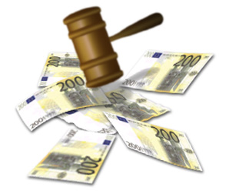
What are the risks of non-compliance with the FCPA?
  Companies may be subject to criminal and/or civil fines, injunctions, disgorgement, reputational damage and collateral consequences including private litigation, debarment from U.S. government and/or multi-lateral bank contracting, loss of executives through termination or resignation and forced oversight of compliance by independent compliance monitors.
  Individuals may face criminal and/or civil fines and imprisonment and loss of employment.
  Expensive internal investigations
  Aggressive enforcement by U.S. authorities, above that currently found in most other countries with similar laws

Slide 12
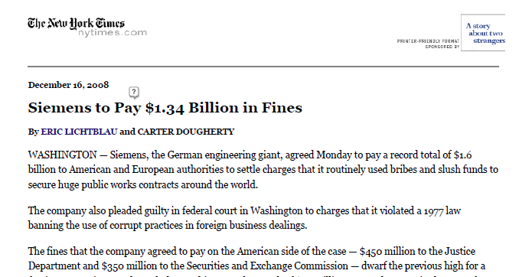
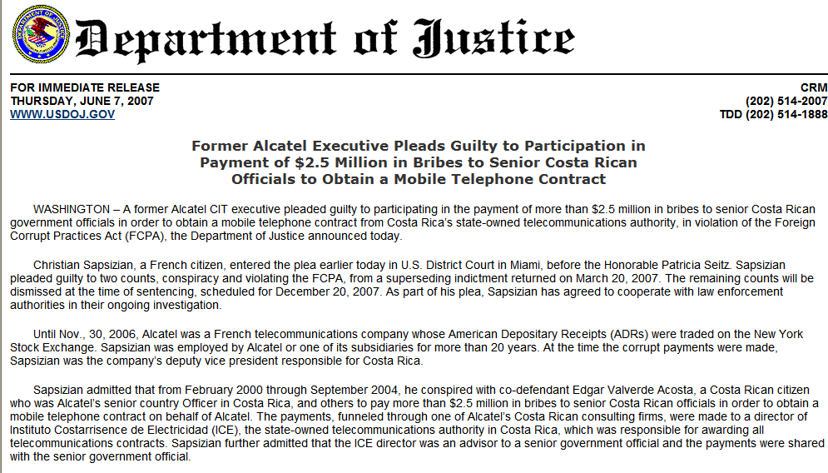
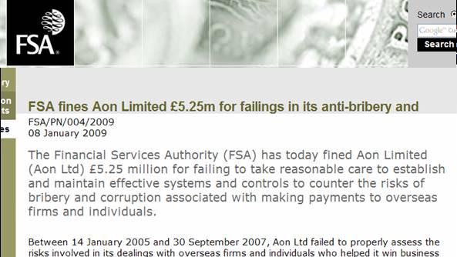
Siemens agreed to pay a record $800 million in penalties to the DOJ and SEC.
French citizen faces possible 10 years in prison, $250,000 fine, and $330,000 in forfeiture.
“…the largest financial crime related fine imposed by the FSA to date.”
Notes:
This slide demonstrates that enforcement actions are on the rise, not only in the U.S. but in the UK as well.
In addition, the prosecution of individuals is a trend that the DOJ has indicated will continue.
Note that Siemens not only paid a large fine to the U.S. Government, but also paid EUR 775 in fines to German authorities in connection with allegations of widespread corruption.
Siemens: http://www.nytimes.com/2008/12/16/business/worldbusiness/16siemens.html?_r=1
Aon: http://www.fsa.gov.uk/pages/Library/Communication/PR/2009/004.shtml
Alcatel: http://www.usdoj.gov/criminal/pr/press_releases/2007/06/06-07-07csapsizian-plea.pdf

Slide 13
What Do the FCPA Anti-Bribery Provisions Prohibit?
Key Elements: The Simple Version
  the offer, promise, giving or authorization of the giving
  of anything of value
  to a non-U.S. government official (very broadly defined)
  for an improper or corrupt purpose, i.e., hoping for a quid pro quo

Slide 14
THE ANTI-BRIBERY PROVISIONS: SPECIFIC ELEMENTS
A violation of the anti-bribery provisions occurs when
  A person covered by the FCPA (or conspirator or aider and abettor)
  Performs any act (using the instruments of interstate commerce or while otherwise being subject to U.S. jurisdiction) in furtherance of
  An offer, gift, promise or authorization of the giving of
  “Anything of value”
  To a non-U.S. government official
  Whether “directly or indirectly”
  For an improper purpose: i.e. to influence or induce the official to misuse his/her official position.
  Unless it falls within an FCPA exception or an affirmative defense would succeed

Slide 15
COVERED PERSON: To whom does the FCPA apply?
U.S. residents
Businesses organized outside the U.S. with principal place of business in the U.S.
Non-U.S. issuers of U.S. securities
Any non-U.S. individual or foreign entity “while in the territory of the United States”
Officers, directors, employees and agents of the foregoing; stockholders acting on their behalf
But only if they are using instrumentalities of interstate commerce in furtherance of an impermissible act

Slide 16
COVERED PERSON: To whom does the FCPA apply?
“U.S. Persons,” meaning:
    U.S. citizens
    U.S. organized entities (including issuers)
  U.S. Persons who are officers, directors, employees, agents or stockholders acting on behalf of U.S. organized issuers
  Anywhere, whether or not using instrumentalities of interstate commerce

Slide 17
COVERED PERSON: To whom does the FCPA apply?
Non-U.S. subsidiaries of an issuer are not themselves subject to the anti-bribery provisions of the FCPA, but they:
  may be deemed to be agents of the U.S. parent
  may have U.S.-citizen employees who are subject to FCPA
  will be subject to local anti-bribery and other laws
The SEC holds U.S. issuers accountable for inadequate internal accounting controls or inaccurate books and records when subsidiaries disguise bribes to foreign officials even if the U.S. issuer does not know or have reason to know that the books and records of the subsidiary are inaccurate.

Slide 18
Instrumentalities of Interstate Commerce
Telephone calls
Faxes
E-mails
U.S. mail or other carrier services
U.S. travel
Make an entry in records
Wiring money through a bank in the U.S.

Slide 19
Key Differences between UK Bribery Act 2010 and the FCPA include :
  Covers commercial bribery in addition to bribery of public officials
  No statutory exceptions (but possible prosecutorial discretion) for “grease” payments
  Defense at the corporate level for having adequate procedures

Slide 20
International Conventions

Slide 21
Inter-American (“OAS”) Convention Against Corruption (1997)
Requires each Party to criminalize:
  Bribery of, and receipt of bribes by, national officials
  Bribery of foreign officials:
    to “prohibit and punish the offering or granting, directly or indirectly, by its nationals [and residents (including businesses)], to a government official of another State, of any article of monetary value, or other benefit, such as a gift, favor, promise or advantage, in connection with any economic or commercial transaction in exchange for any act or omission in the performance of that official’s public functions”
  Illicit enrichment, i.e., a significant increase in the assets of an official that he cannot reasonably explain (U.S. took reservation on grounds that placing burden of proof on defendant would violate the U.S. Constitution)
  Fraudulent use or concealment of property derived from an act of corruption
  Participation in the commission, or attempted commission, of, or in any collaboration or conspiracy to commit, an act of corruption

Slide 22
OECD Convention on Combating Bribery of Foreign Public Officials in International Business Transactions (1998)
Requires each Party to criminalize:
  Bribery of foreign officials:
    “to establish that it is a criminal offense . . . for any person intentionally to offer, promise or give any undue pecuniary or other advantage, whether directly or through intermediaries, to a foreign public official, for that official or for a third party, in order that the official act or refrain from acting in relation to the performance of official duties, in order to obtain or retain business or other improper advantage in the conduct of international business”
  Complicity, including incitement, aiding and abetting or authorization of an act of bribery of a foreign public official
  Attempt and conspiracy, if they are crimes with respect to domestic bribery
Also requires each Party to:
  make bribery of a foreign official a predicate offense for money laundering if it is a predicate offense with respect to domestic bribery

Slide 23
Council of Europe Criminal Law Convention on Corruption (2002)
Requires each Party to criminalize:
  Bribery of, and receipt of bribes by, national officials
  Bribery of, and receipt of bribes by, foreign public officials
    To prohibit, “when committed intentionally, the promising, offering or giving by any person, directly or indirectly, of any undue advantage to any [foreign public official], for himself or herself or for anyone else, for him or her to act or refrain from acting in the exercise of his or her functions,” and the request or receipt by any foreign public official of such an advantage, or the acceptance of such an offer or promise
  Bribery in the private sector, both active (gift) and passive (receipt)
    Trading in influence (bribes to anyone and receipt of a bribe by anyone who asserts that he is able to exert an improper influence over the decision-making of a national or foreign official)
    Money-laundering of proceeds from corruption offenses
    Intentional creation or use of false or incomplete records, or unlawful failure to make a record, in order to commit, conceal or disguise an act of corruption
    Aiding or abetting the commission of any criminal offense established in accordance with the Convention
The Convention also requires measures to enable confiscation of the proceeds of criminal offenses or property of equal value, and mutual legal assistance

Slide 24
UN Convention Against Corruption
Some provisions required; some urged for consideration
Requires each Party to criminalize:
  Bribery of, and receipt of bribes by, national officials
  Bribery of foreign public officials
    To prohibit, “when committed intentionally, the promise, offering or giving to a foreign public official or an official of a public international organization, directly or indirectly, of an undue advantage, for the official himself or herself or another person or entity, in order that the official act or refrain from acting in the exercise of his or her official duties, in order to obtain or retain business or other undue advantage in relation to the conduct of international business”
  Embezzlement, misappropriation or diversion of public funds by public official
  Conversion, transfer, disguise or use of property knowing that it is the proceeds of corruption
  Offenses in support of corruption (obstruction of justice, money laundering, participation as accomplice, assistant or instigator)
Invites each Party to consider criminalizing:
  Private sector bribery and embezzlement
  Trading in Influence
  Receipt of bribes by foreign public officials

Slide 25
African Union Convention on Preventing and Combating Corruption
Entered into force August 5, 2006
Requires parties to, among other things:
  Adopt legislative and other measures that are required to establish as offences [the solicitation or acceptance, directly or indirectly, by a public official or any other person, or any goods of monetary value, or other benefit, such as a gift, favour, promise or advantage for himself or herself or for another person or entity, in exchange for any act or omission in the performance of his or her public functions]…
  Adopt legislative and other measures to prevent and combat acts of corruption and related offences committed in and by agents of the private sector
  Establish mechanisms to encourage participation by the private sector in the fight against unfair competition, respect of the tender procedures and property rights
  Adopt such other measures as may be necessary to prevent companies from paying bribes to win tenders

Slide 26
How can I leverage from this knowledge?
Public information (see the following slide for the links)
Legal co-operation
Exchange of information – tactical

Slide 27
Next steps – Some Useful Websites
Department of Justice: www.usdoj.gov/criminal/fraud/fcpa/
Department of State: www.state.gov/e/eb/cba/gc/
Organization of American States (OAS): www.oas.org
Organization for Economic Cooperation and Development (OECD): www.oecd.org (click on by topic > governance fighting corruption > OECD convention/texts)
Council of Europe: http://conventions.coe.int (click on search treaties > search by CETS) (Criminal Law Convention is CETS 173, Civil Law is CETS 174)
UN Convention Against Corruption: www.unodc.org/unodc/en/treaties/CAC/index.html
Transparency International: www.transparency.org
2008 CPI Index: www.transparency.org/news_room/in_focus/2008/cpi2008/cpi_2008_table
African Union Organization: www.africa-union.org/root/au/index.htm (click on documents > treaties, conventions & protocols > african union convention on preventing and combating corruption

Slide 28
Thank-you

